Slide 1


Azure Synapse
Delta Lake - Spark, Serverless, SQL Pools & Beyond
Hiram Fleitas
Senior Customer Engineer, Data & AI
bit.ly/sql1021slides

Slide 2
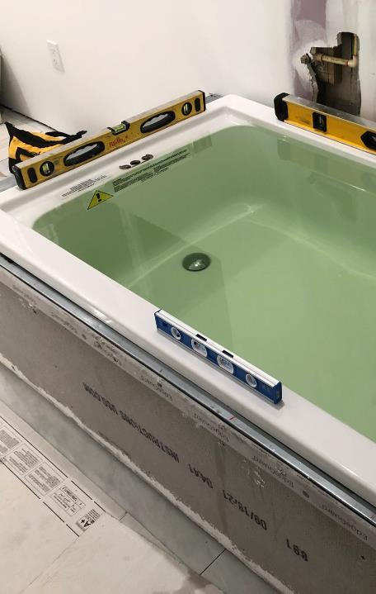
Machine Learning
Synapse Analytics
Power Platform
DevOps
About Me
aka.ms/hiram

Slide 3
Objective
I have a big data transactional CDC (change data capture) workload in delta format. This is very common in Databricks, but how does it work on Synapse?
Why? Because you can and you'd like to host/join/index your data in a static-layer to serve n-Number of queries.

Slide 4
What is Azure Synapse?
Limitless analytics service includes:
Data Integration
Enterprise data warehousing
Big data analytics
Provides unified experience to:
Ingest
Explore
Prepare
Manage
Serve
Business Intelligence
Machine Learning
Ref: aka.ms/azuresynapse

Slide 5
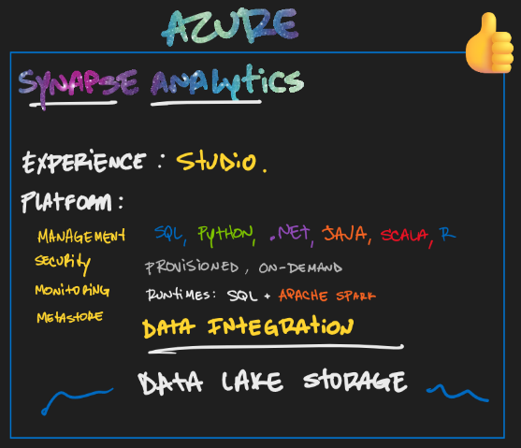
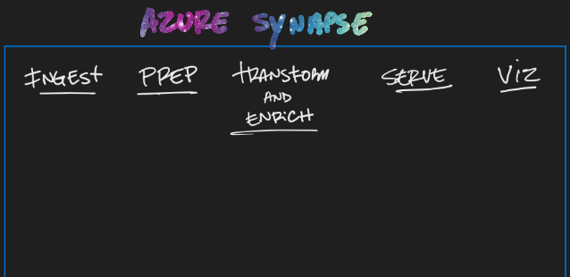





Notes:
Ref: https://techcommunity.microsoft.com/t5/azure-synapse-analytics/query-delta-lake-files-using-t-sql-language-in-azure-synapse/ba-p/2388398

Slide 6
What is Synapse Spark?
In-memory parallel processing framework for big data analytics.
One of Microsoft’s implementation of Apache Spark.
How does it differ?
A config/definition of what you want a Spark Instance to look like.
Is an Azure Resource
Looks like a Spark Cluster to clients
Is Free (when not being used to run a workload)
Provides isolation and budget control
Can be managed from Azure Portal or Synapse Studio
Is securable
Can have additional libraries installed, different libs on different pools
Can be auto scaled or statically defined
Is NOT a cluster
Ref: docs.microsoft.com/azure/synapse-analytics/spark/apache-spark-overview

Slide 7
What is Delta format?
OSS storage layer for Spark
Provides:
ACID transactions (atomicity, consistency, isolation, and durability)
History of changes
Time travel in data history
Schema evolution
Optimizations:
Z-Ordering: co-locates related info in the same set of files
Bin-Packaging (Compaction): OPTIMIZE command to coalesce small files into larger files.
VACCUM: cleanup old compacted files
Ref: docs.microsoft.com/azure/synapse-analytics/spark/apache-spark-what-is-delta-lake#key-features
Notes:
Ref: https://youtu.be/8-mdnw_L91Y
INTERNAL:
https://microsoft.sharepoint.com/:p:/r/teams/DataAIInsider70/_layouts/15/doc2.aspx?sourcedoc=%7B4B387D17-781C-4C20-9338-0EC74B605279%7D&file=Introduction%20to%20Apache%20Spark%20on%20Synapse.pptx&action=edit&mobileredirect=true&DefaultItemOpen=1&cid=3c6e3b45-cefa-4c0d-ae4e-69c9e48a454b
Delta is a specific format. If know some of the challenges when dealing with GPDR and updates in big data systems. Its incredibly hard to do, its even harder to do well and in a consistent way that auditors will sign off on.
Databricks introduced this format which is based on parquet which is the default format for the lake these days, and actually spark’s default format although it’s switching to delta now.
Delta gives you basic transactional capabilities over the top of parquet, so the transactions are tracked and the transactions are applied.
One of the most important features is time travel (ie. versionAsOf), you can ask for the dataset by time or by transaction id.

Slide 8
Intro
Spark
Serverless
Pipeline
SQL Pools
Resources
Agenda

Slide 9
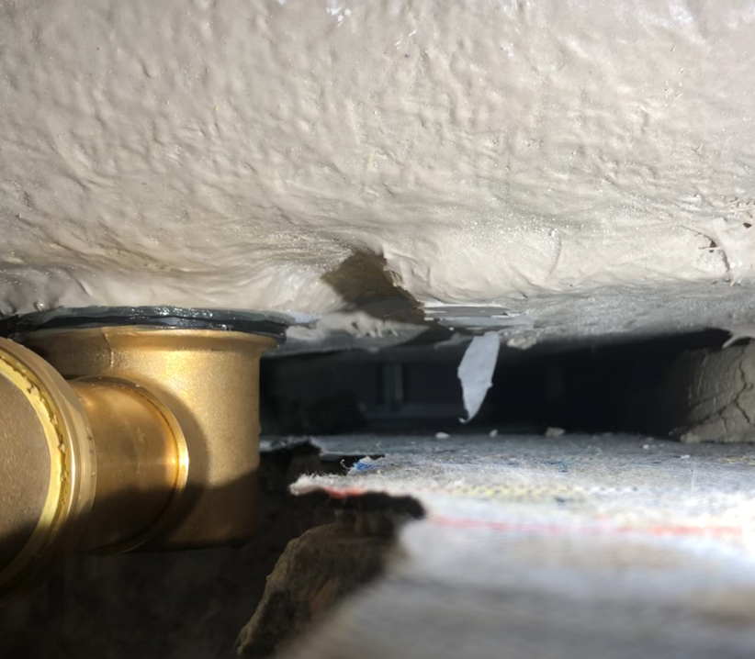
Spark
Scala delta
APIs
SQL magics
Merge
Demo 1
Notebook - DeltaChanges3

Slide 10
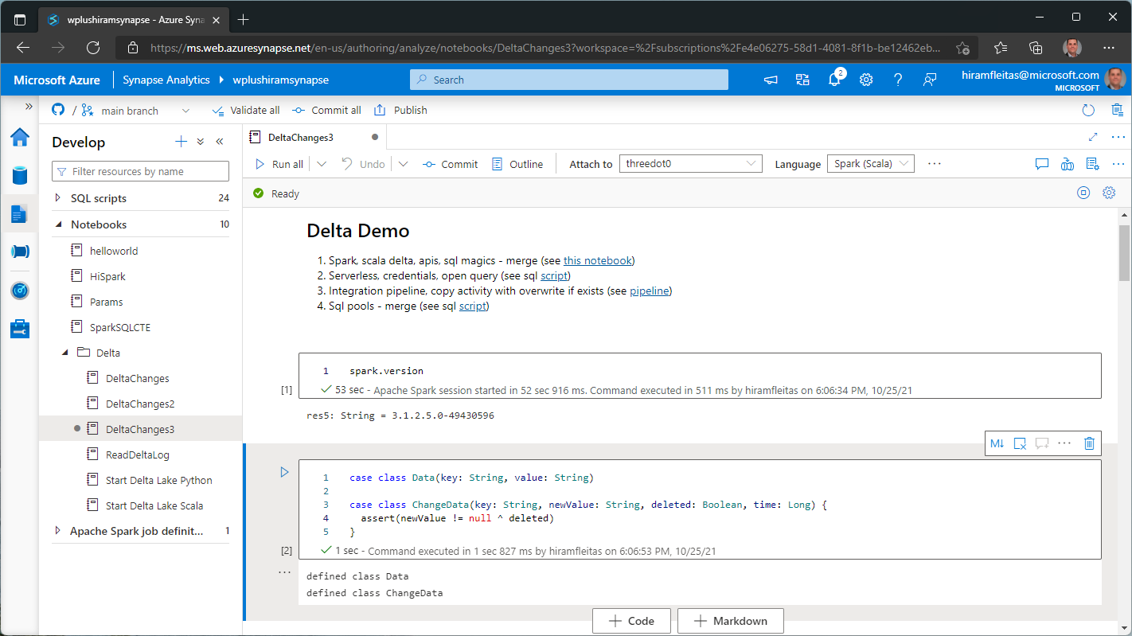

Slide 11
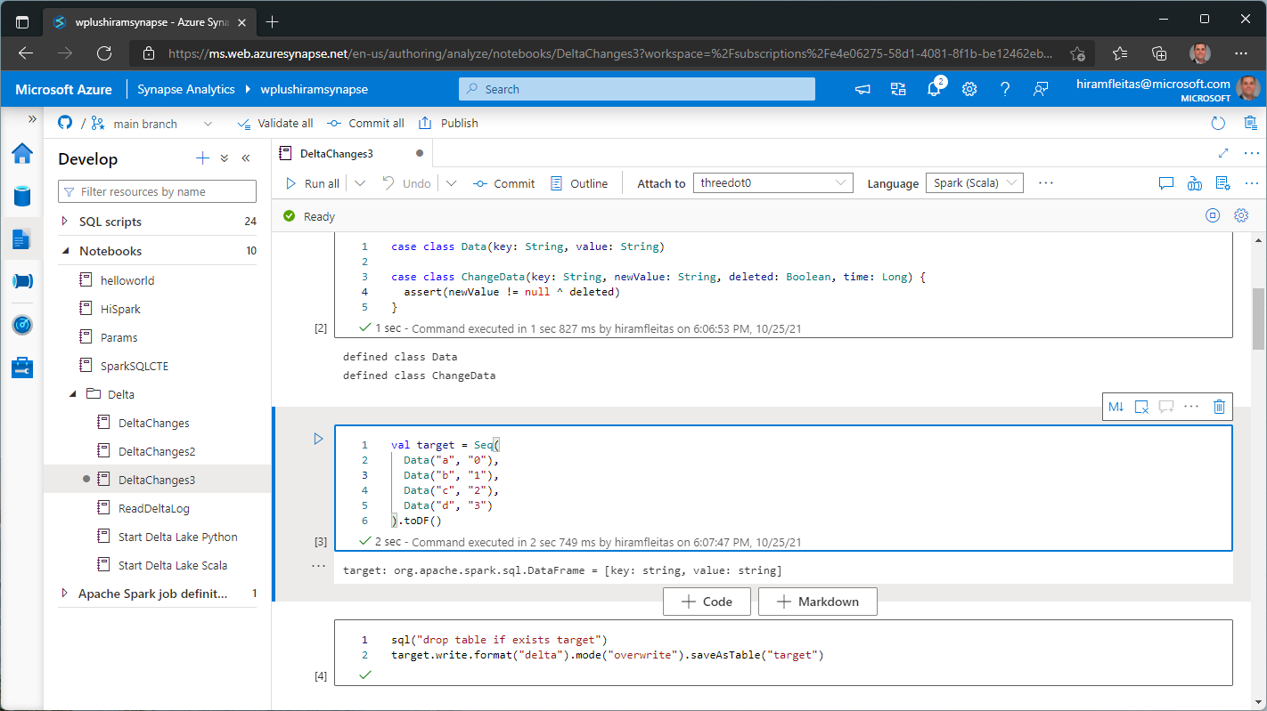

Slide 12
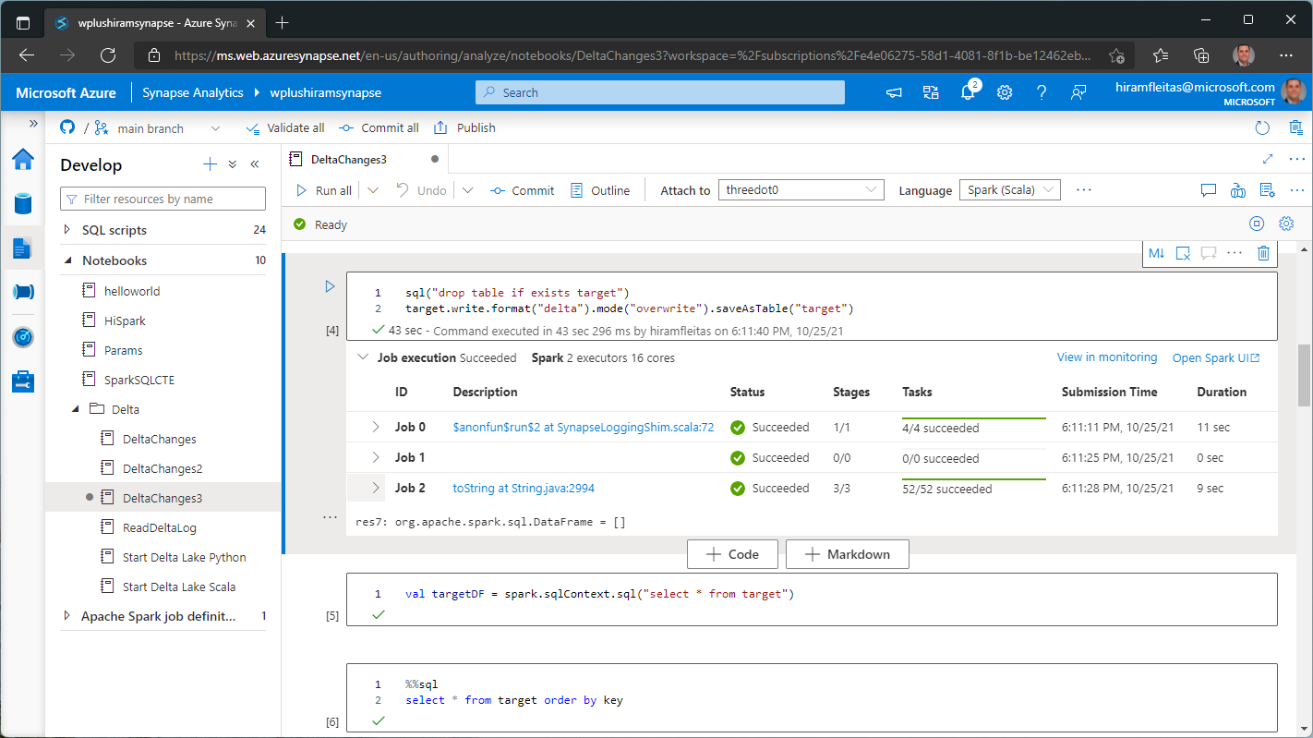

Slide 13
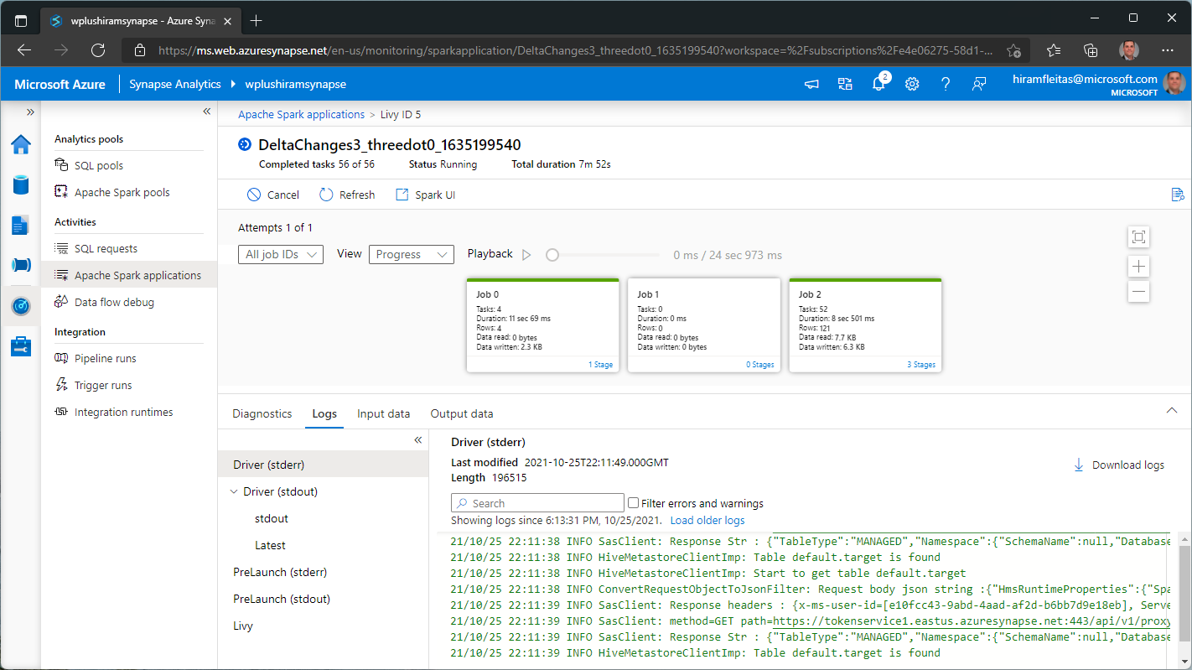

Slide 14
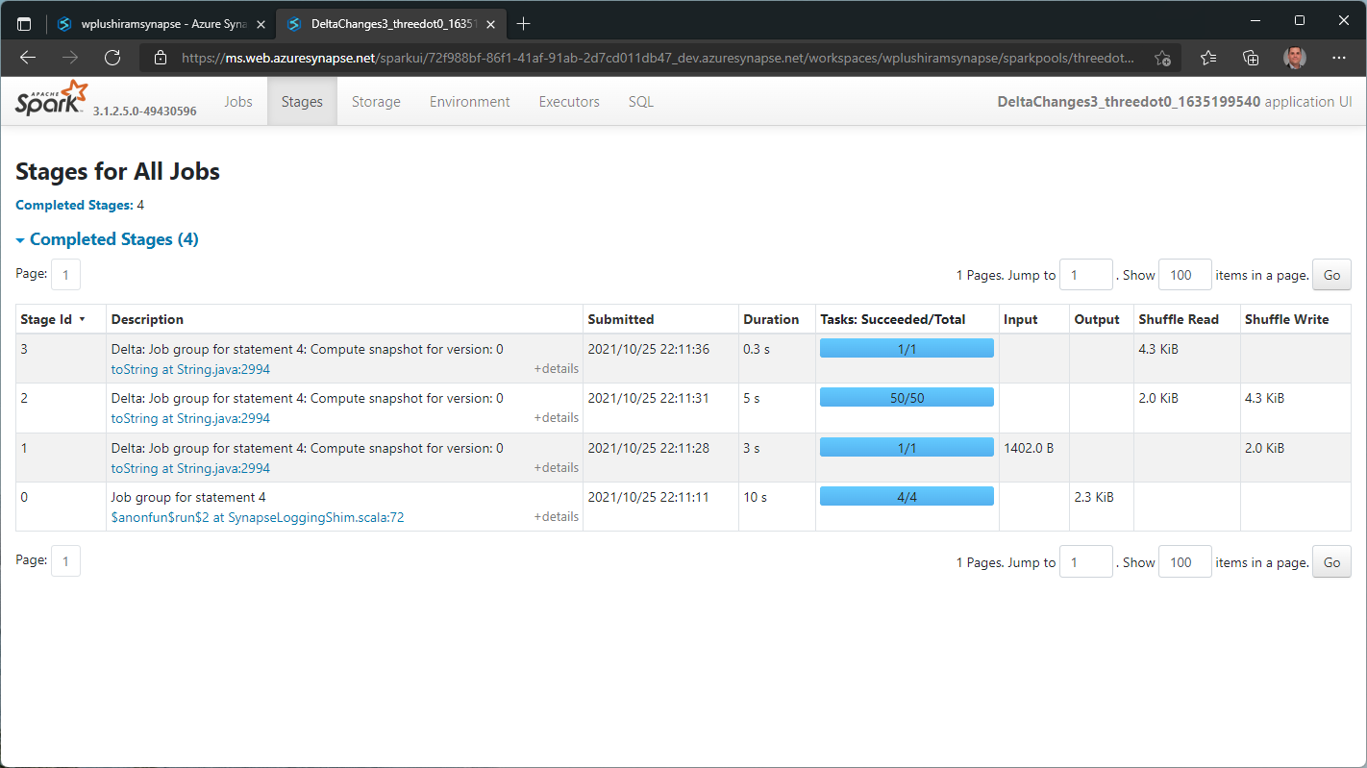

Slide 15
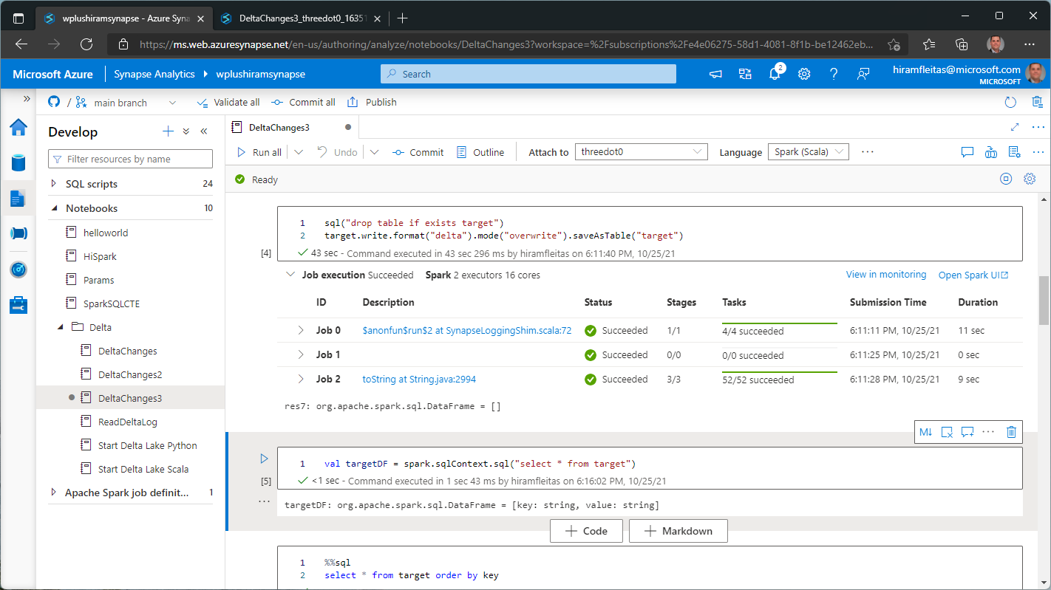

Slide 16
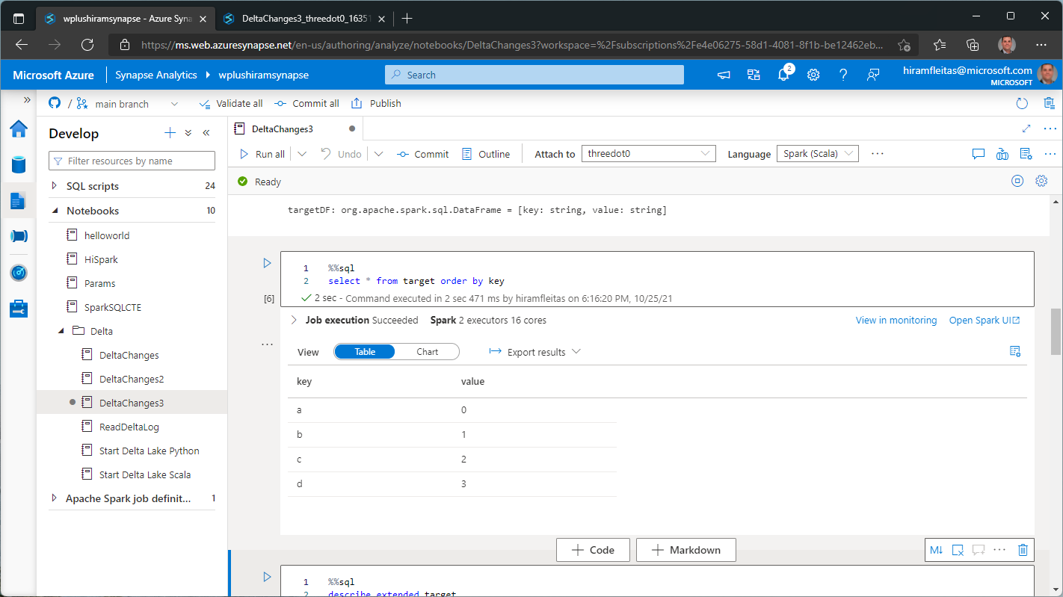

Slide 17
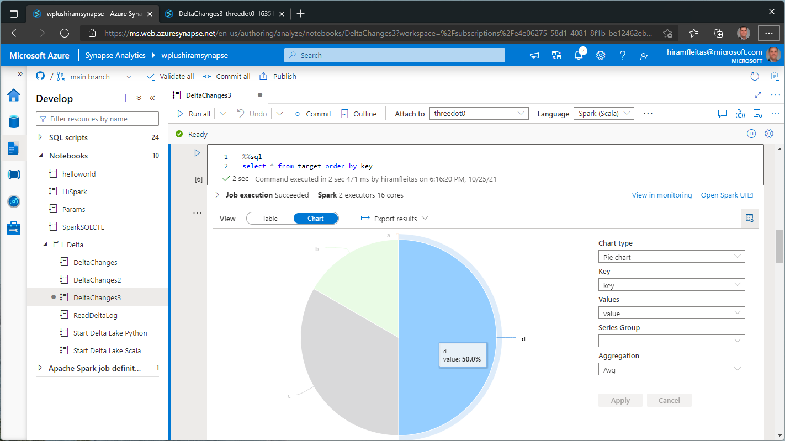

Slide 18
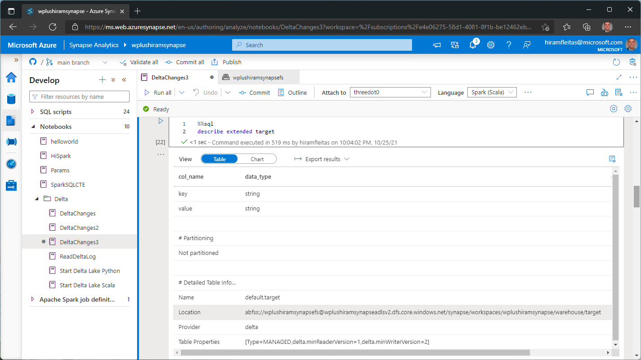

Slide 19
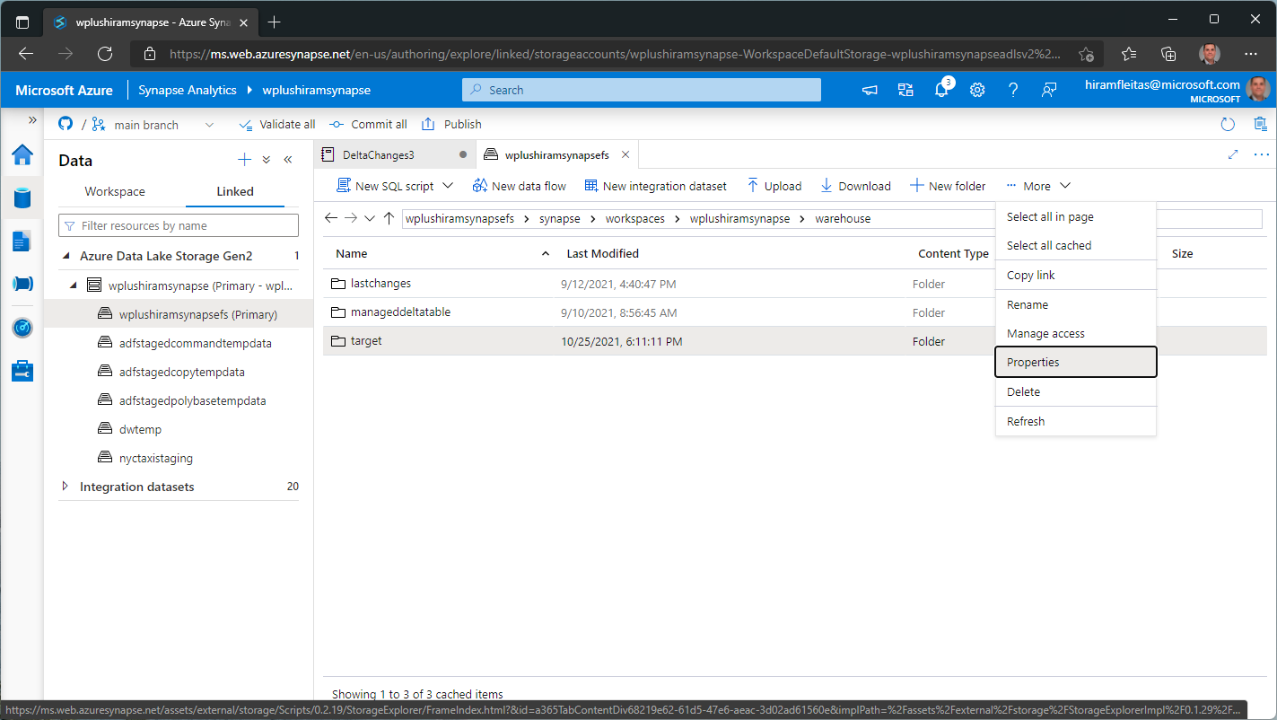

Slide 20
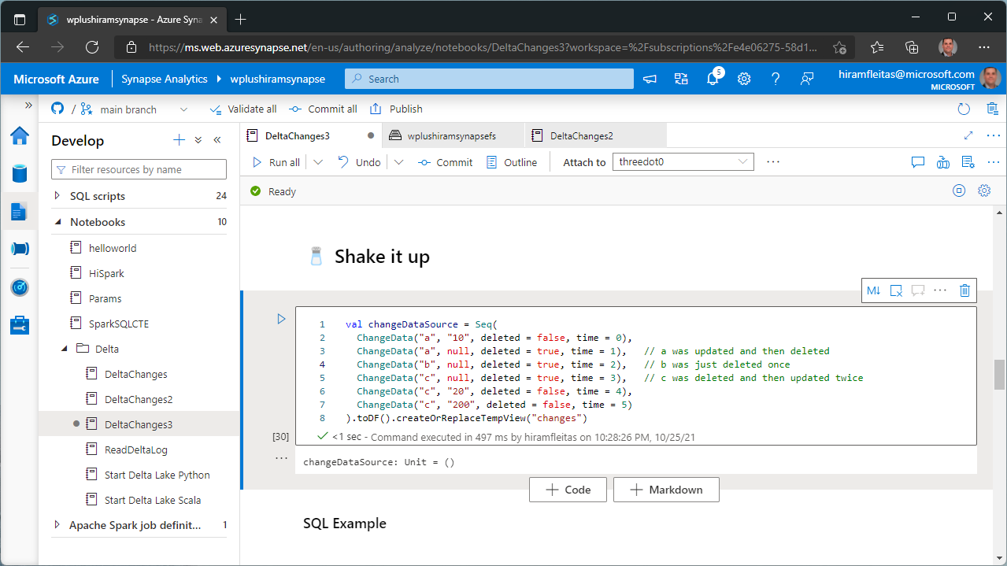

Slide 21
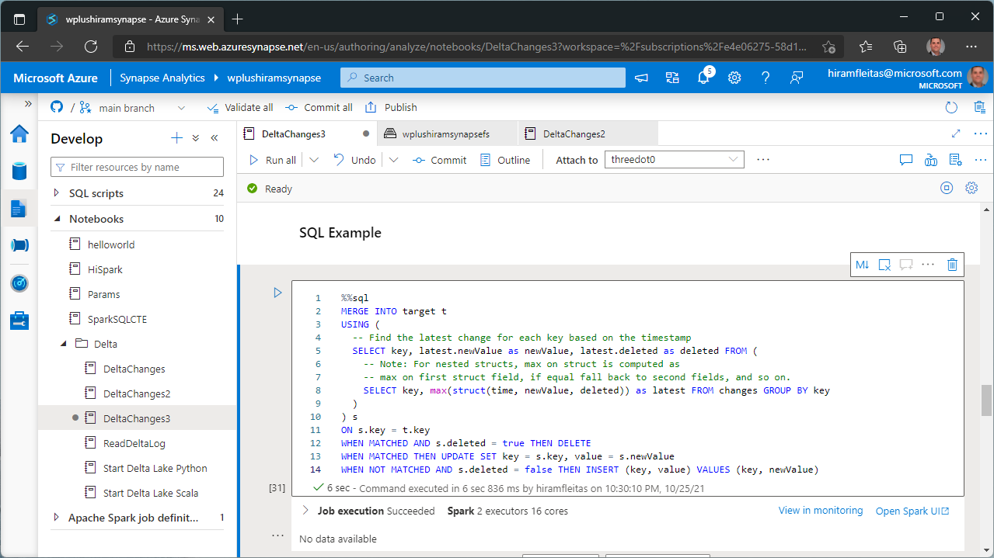

Slide 22
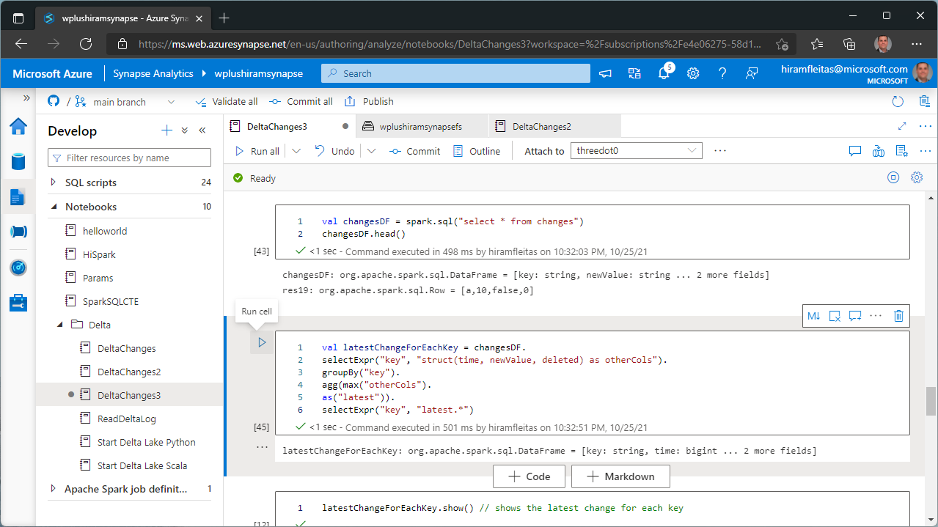

Slide 23
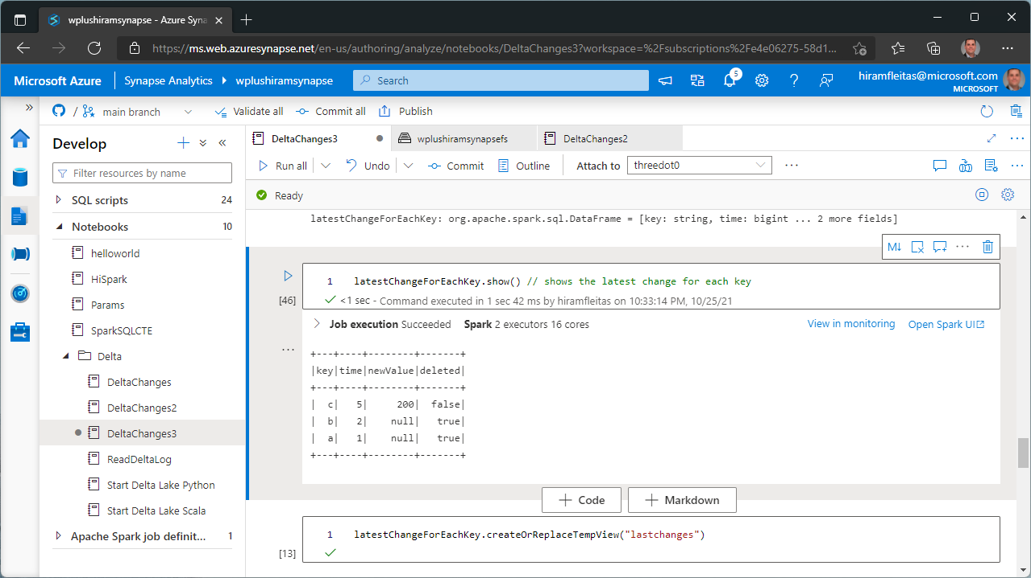

Slide 24
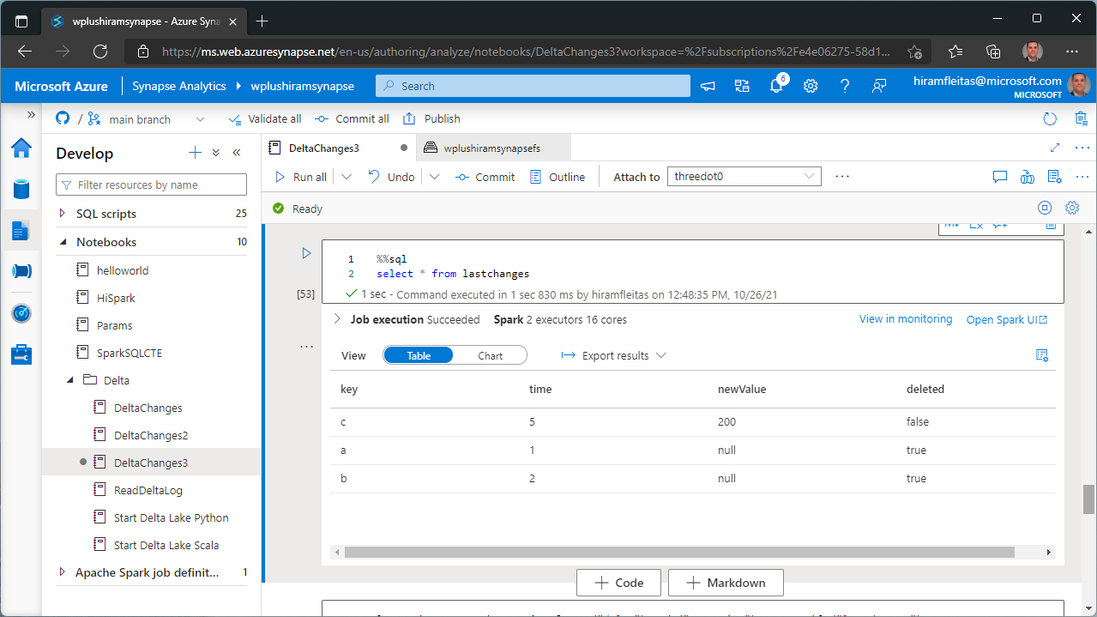

Slide 25
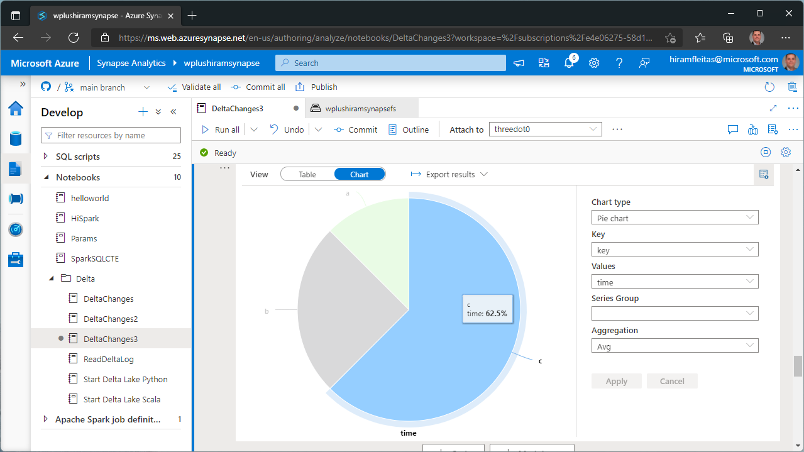

Slide 26
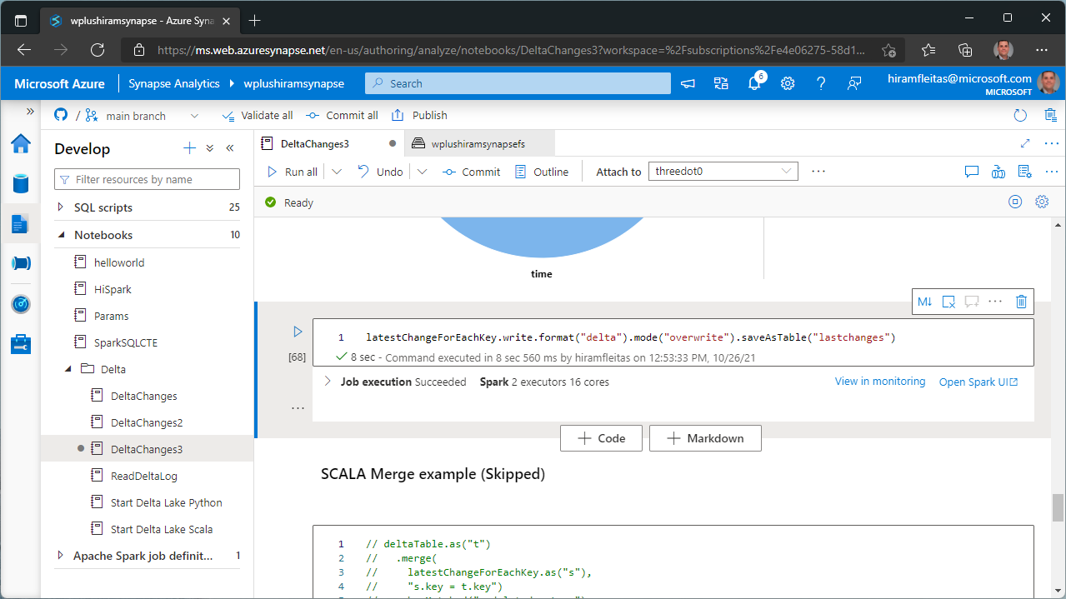

Slide 27
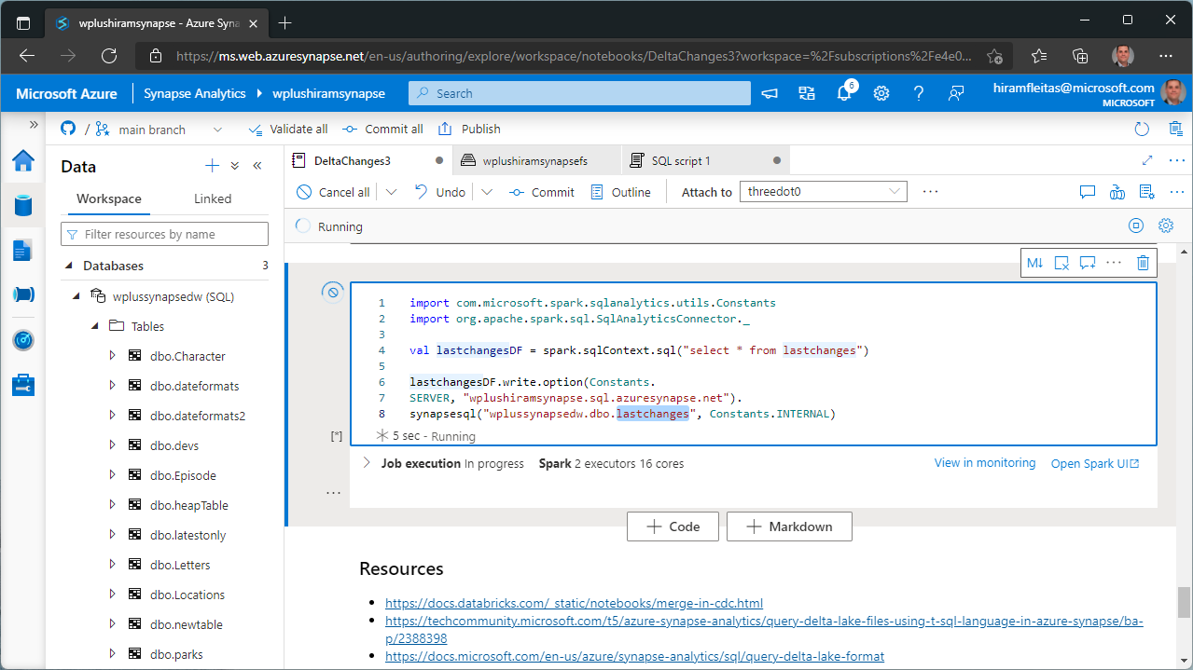

Slide 28
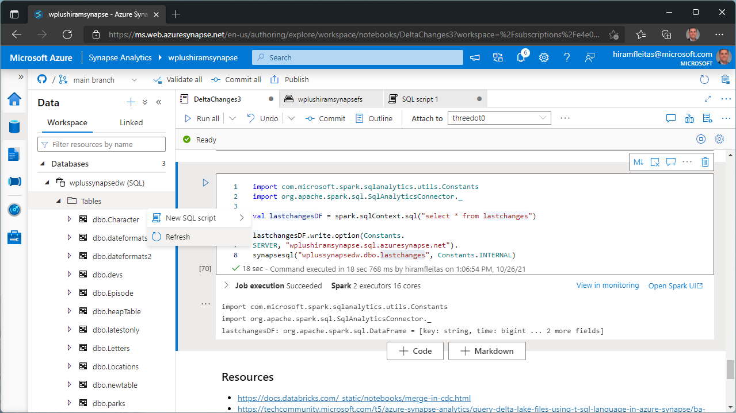

Slide 29
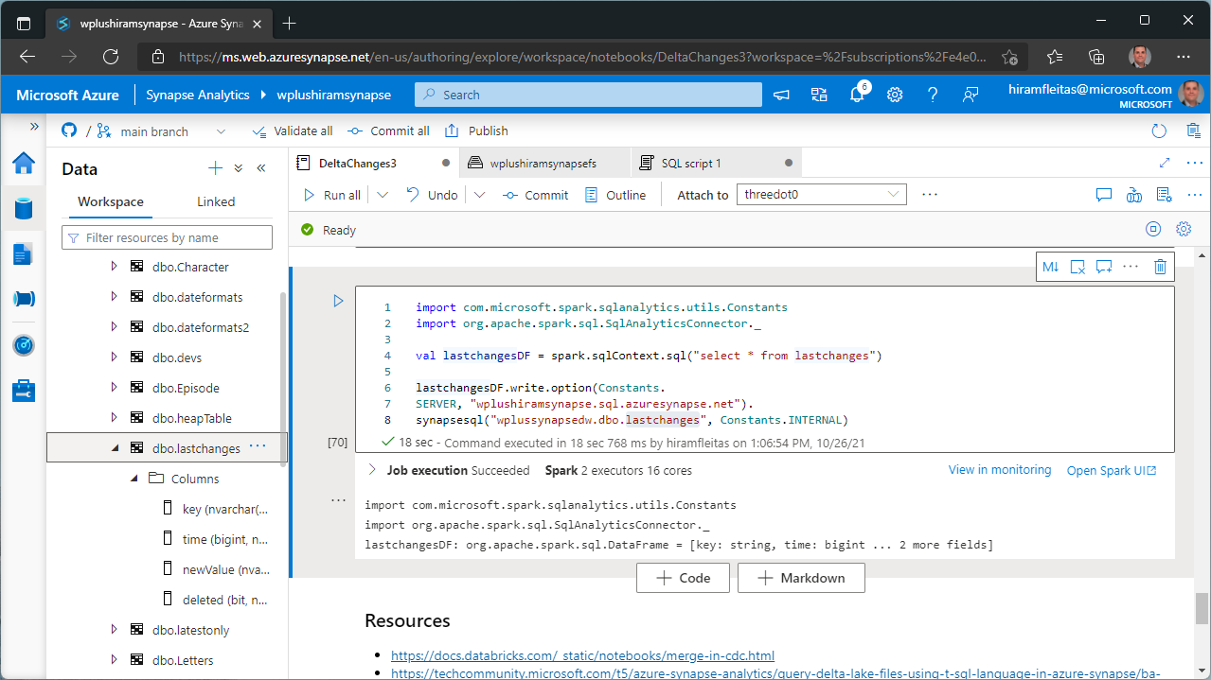

Slide 30
Demo 1 - Resources
github.com/hfleitas/synapsedelta/blob/main/notebook/DeltaChanges3.ipynb
docs.databricks.com/_static/notebooks/merge-in-cdc.html
techcommunity.microsoft.com/t5/azure-synapse-analytics/query-delta-lake-files-using-t-sql-language-in-azure-synapse/ba-p/2388398
docs.microsoft.com/azure/synapse-analytics/sql/query-delta-lake-format
databricks.com/blog/2019/03/19/efficient-upserts-into-data-lakes-databricks-delta.html
docs.microsoft.com/sql/t-sql/statements/merge-transact-sql?view=azure-sqldw-latest
databricks.com/blog/2019/02/04/introducing-delta-time-travel-for-large-scale-data-lakes.html
docs.microsoft.com/azure/synapse-analytics/sql-data-warehouse/sql-data-warehouse-develop-ctas
mssqltips.com/sqlservertip/6282/azure-data-factory-multiple-file-load-example-part-2
docs.microsoft.com/azure/synapse-analytics/spark/synapse-spark-sql-pool-import-export#write-api-1

Slide 31
Demo 2
Credentials
Openrowset
SQL Script - DeltaSrvlessViews

Slide 32
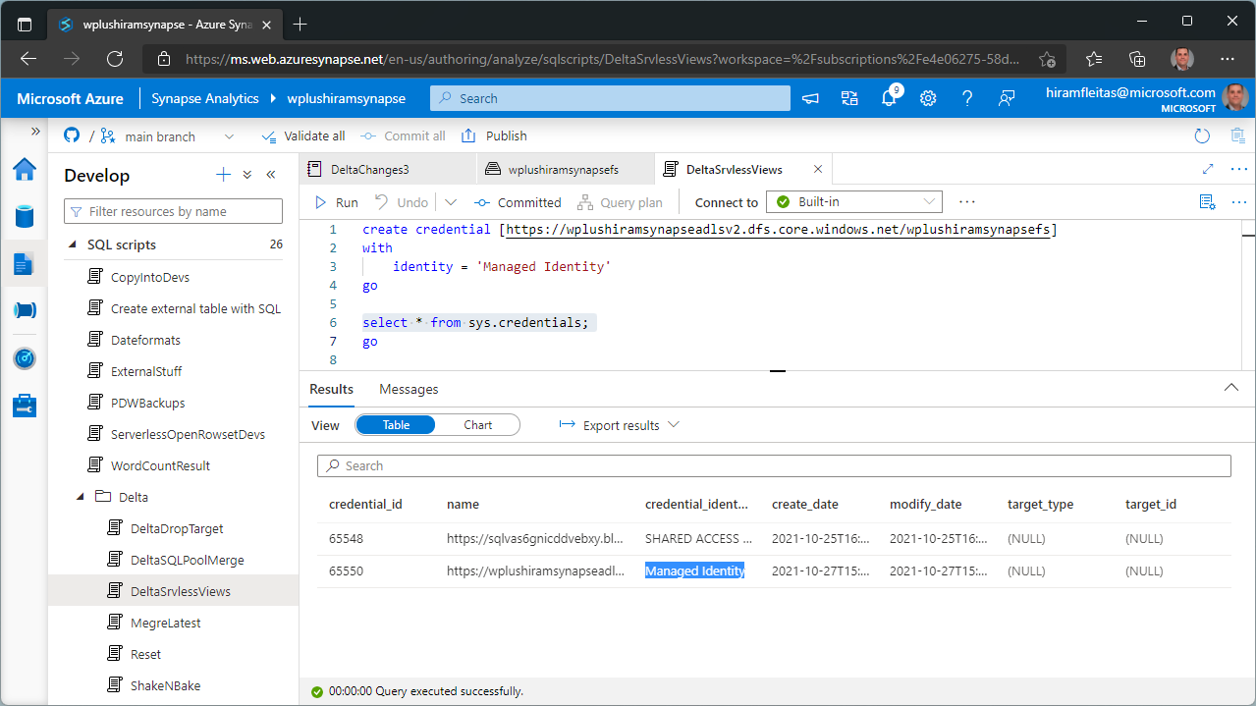

Slide 33
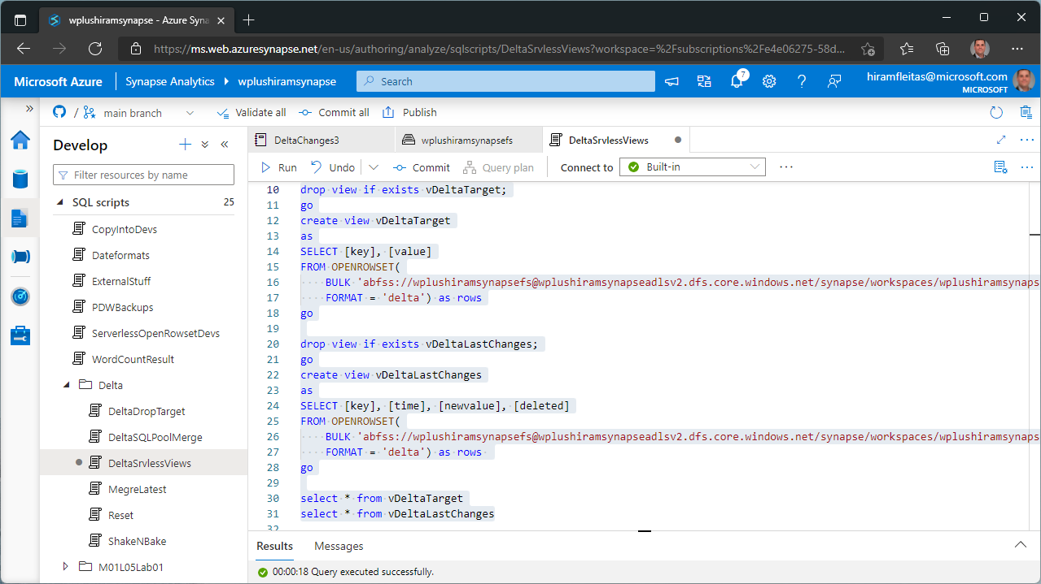

Slide 34
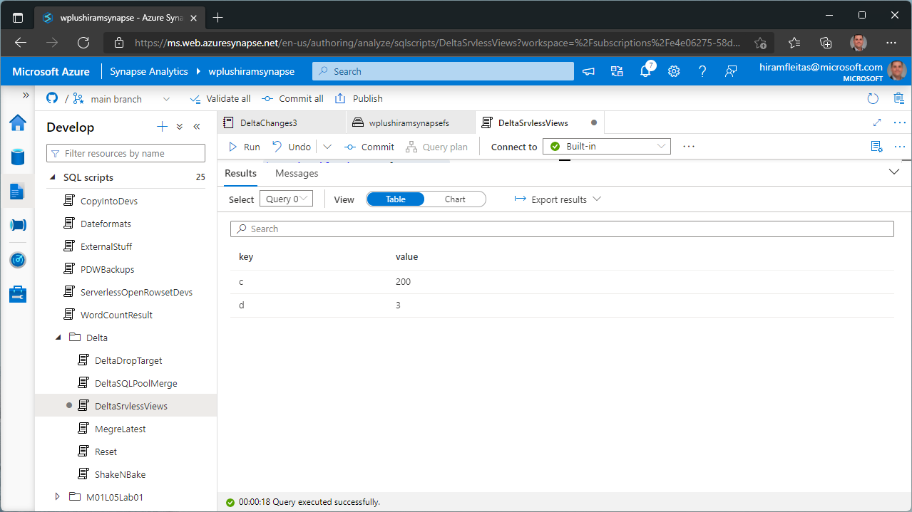
Note,:
Note: changes were merged to target (delta table) in previous demo.

Slide 35
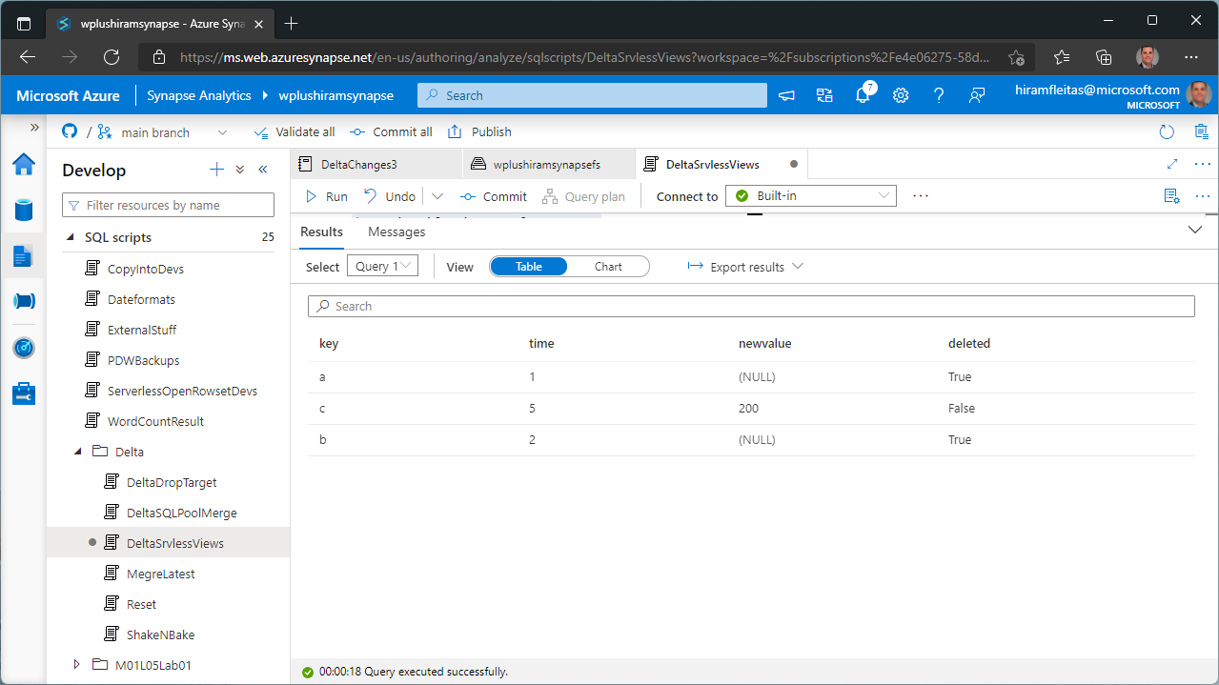

Slide 36
Demo 2 - Resources
github.com/hfleitas/synapsedelta/blob/main/sqlscript/DeltaSrvlessViews.sql
docs.microsoft.com/azure/synapse-analytics/sql/overview-features#data-formats

Slide 37
Pipelines
Notebooks
Copy Activity
Merge
Demo 3
Pipeline: DeltaChanges-Synapse

Slide 38
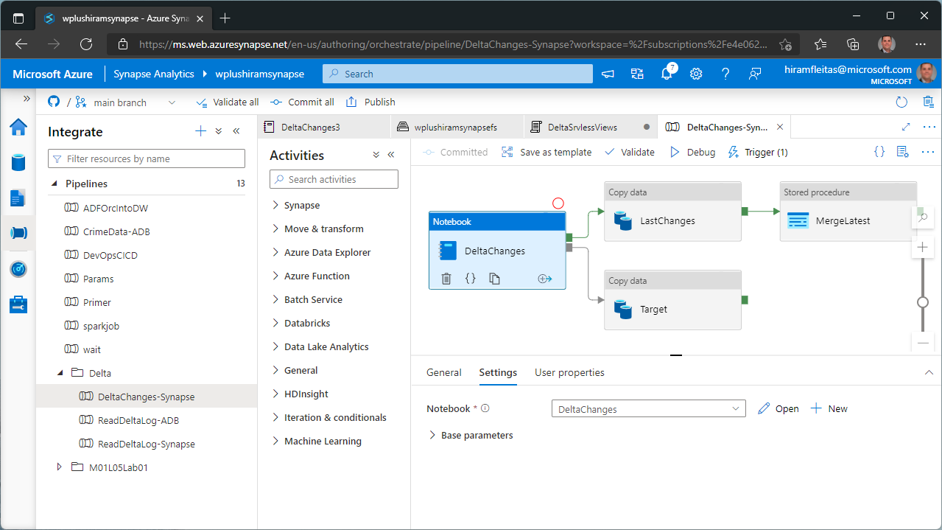

Slide 39
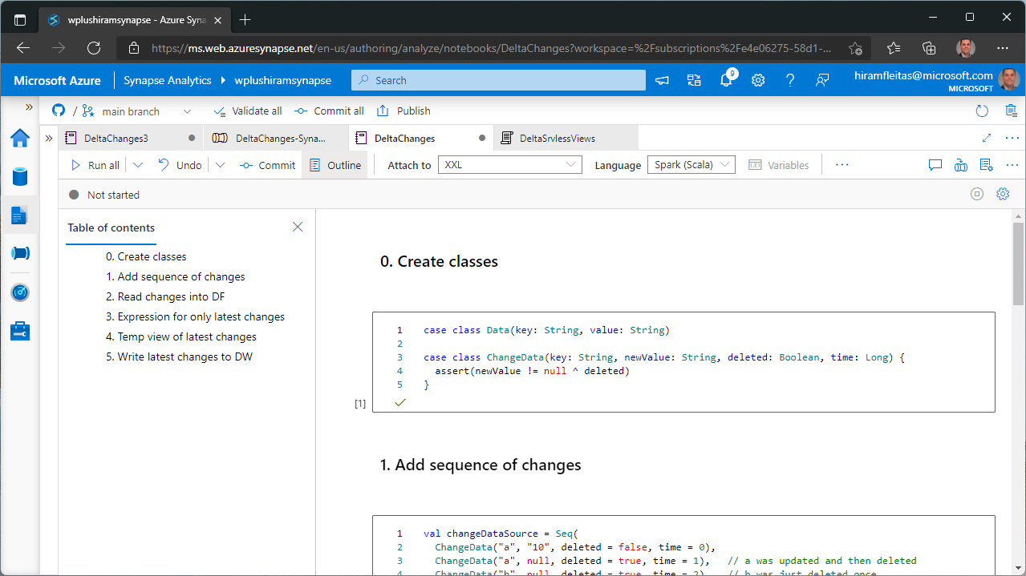

Slide 40
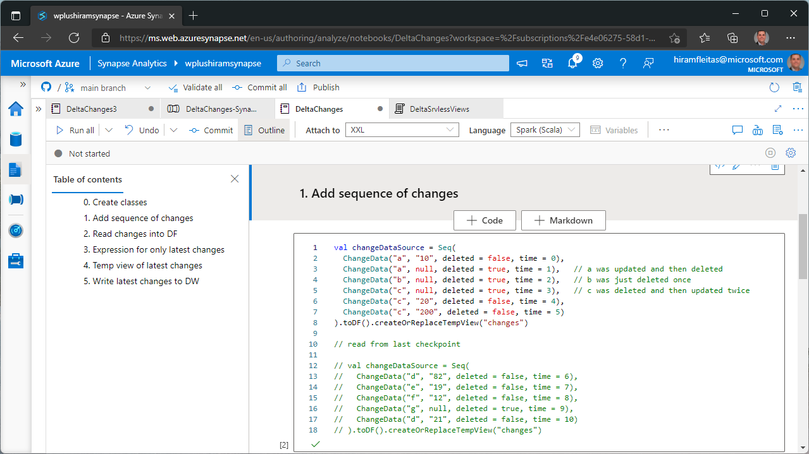

Slide 41
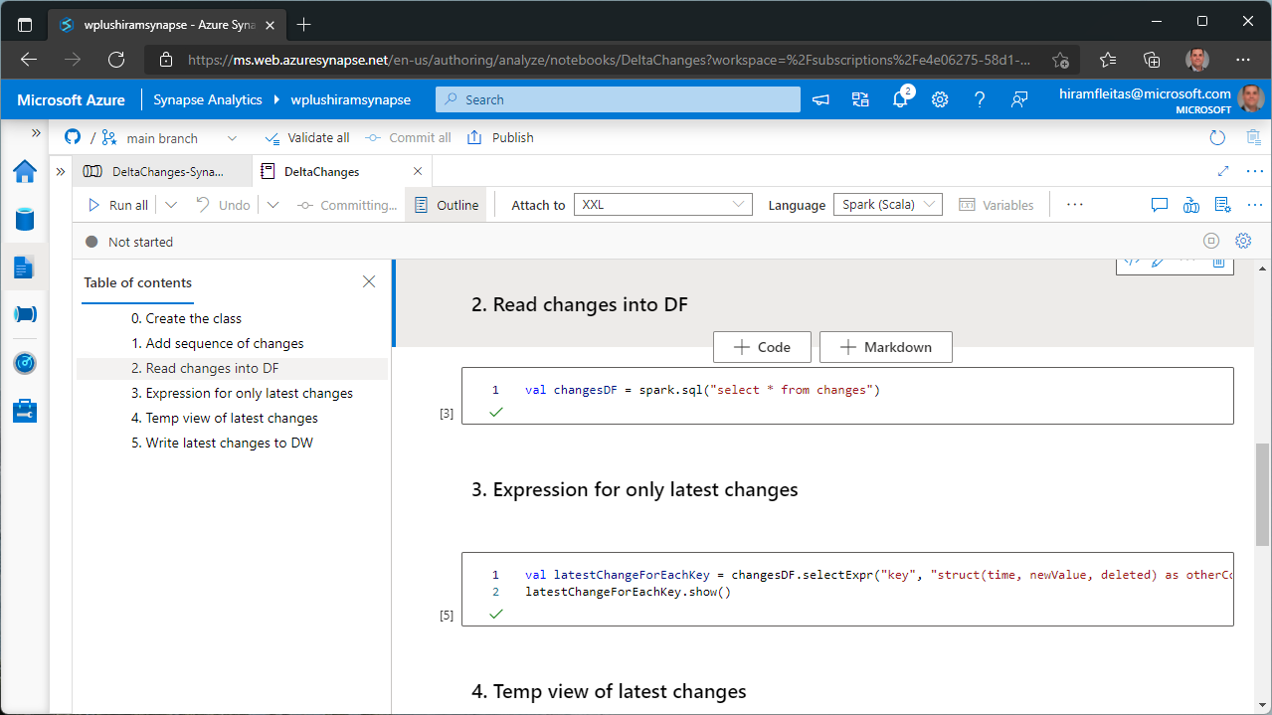

Slide 42
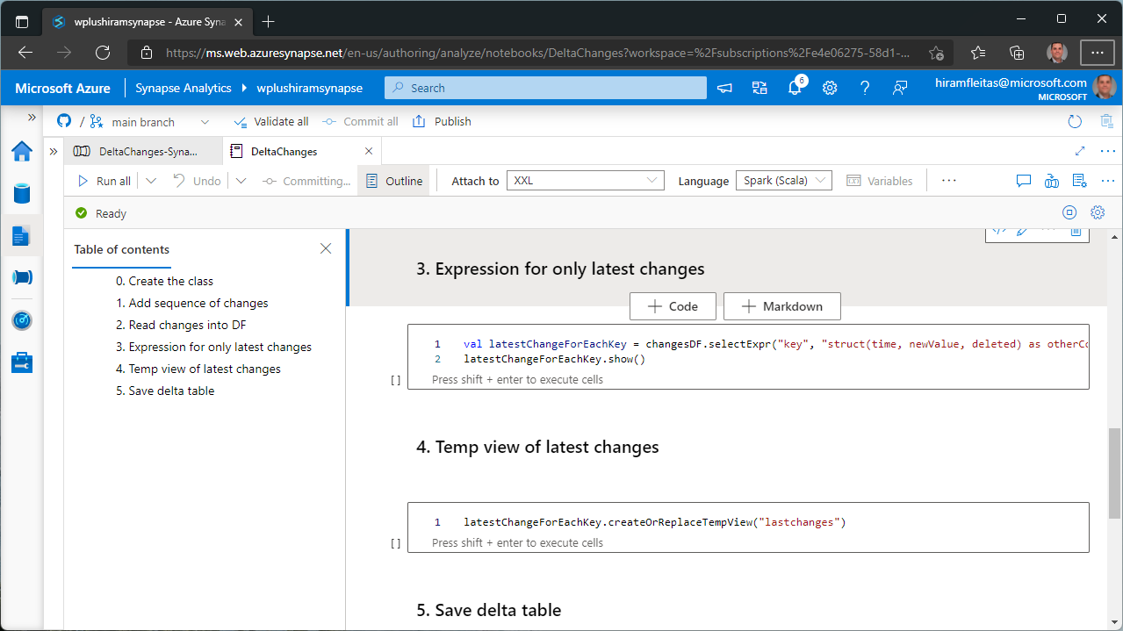

Slide 43
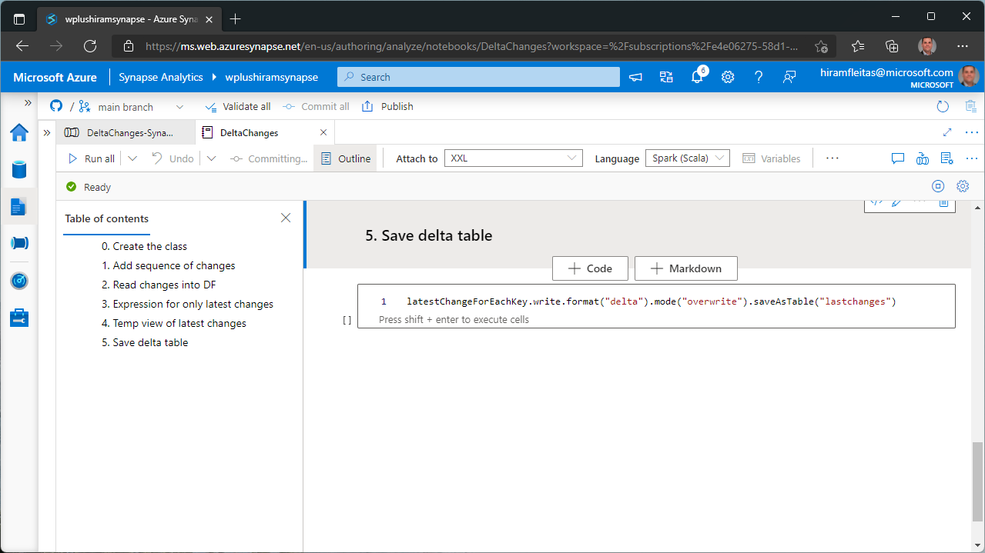

Slide 44
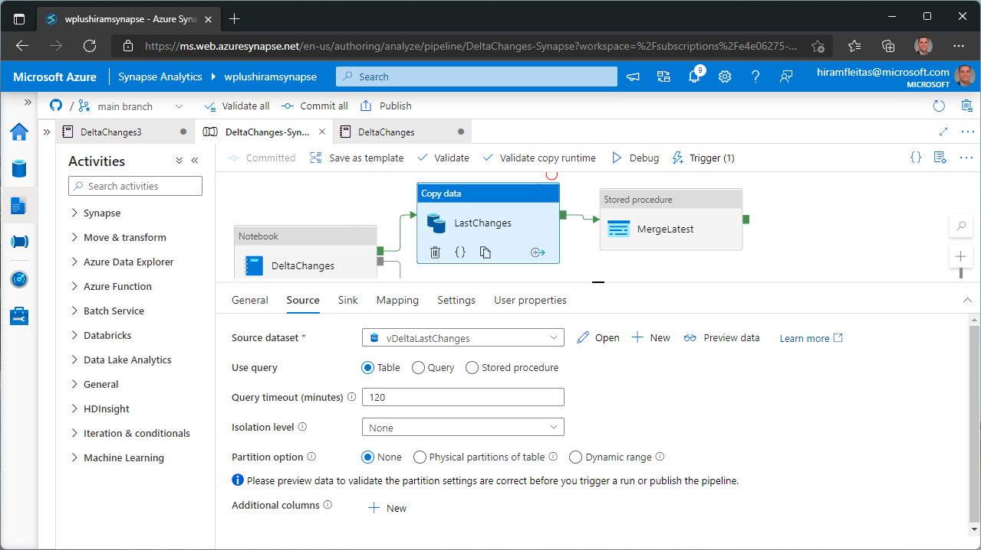

Slide 45
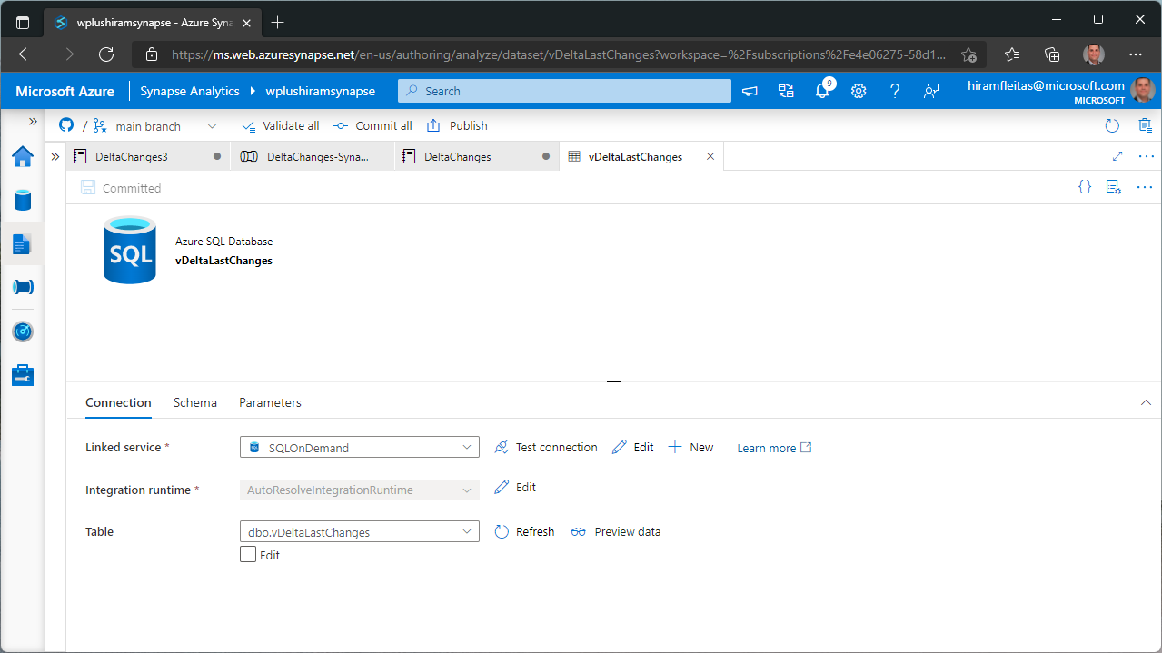

Slide 46
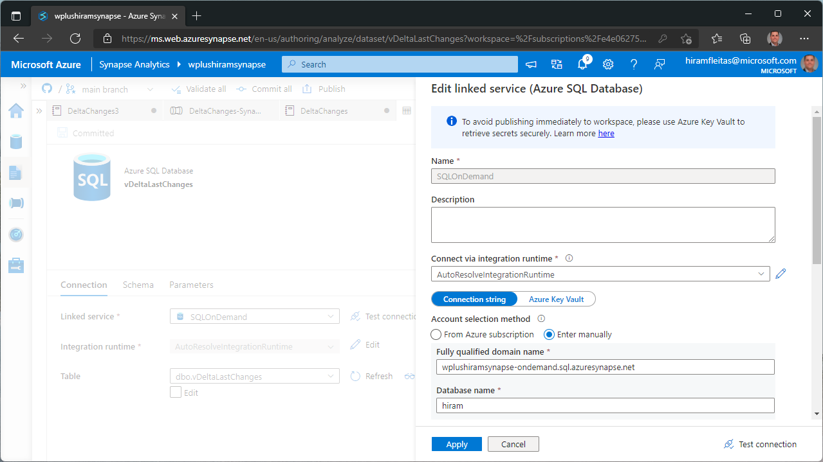

Slide 47
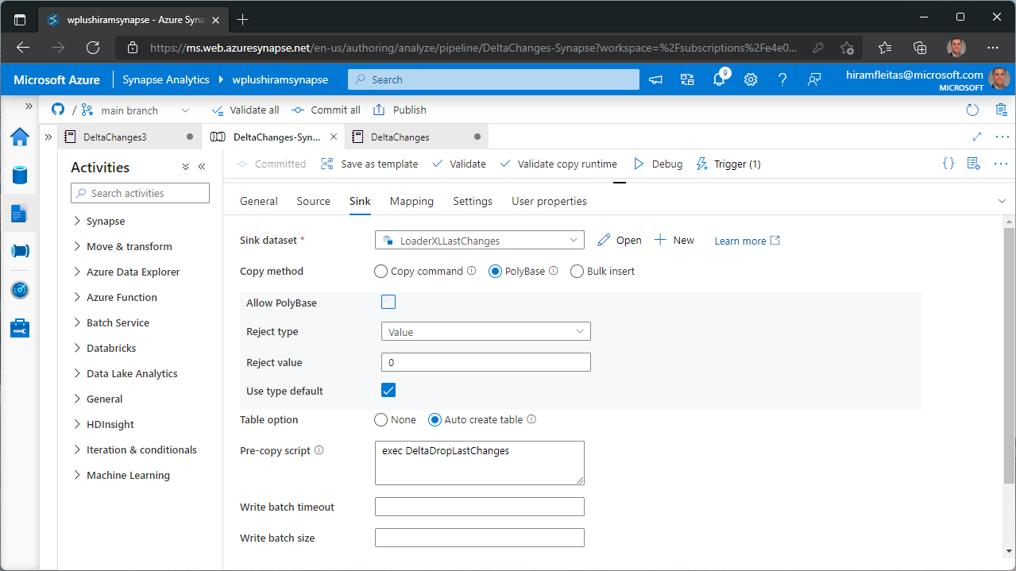

Slide 48
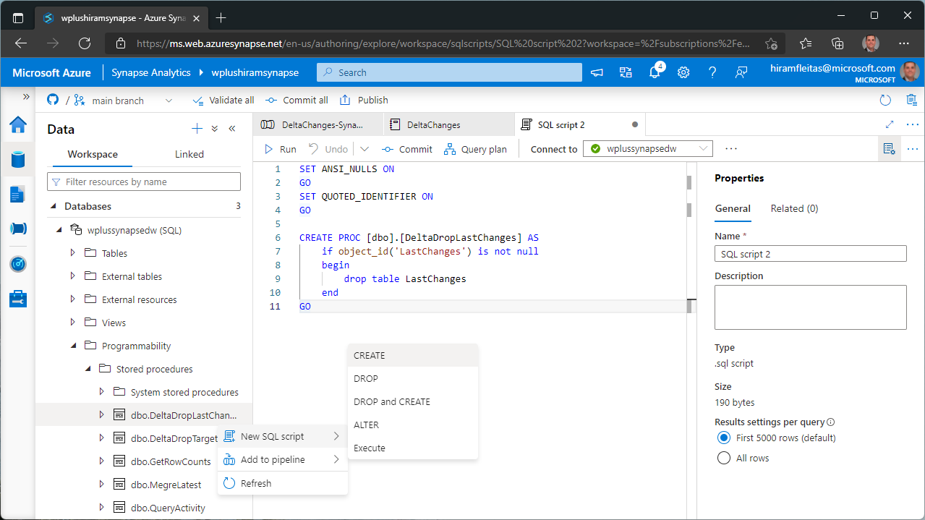

Slide 49
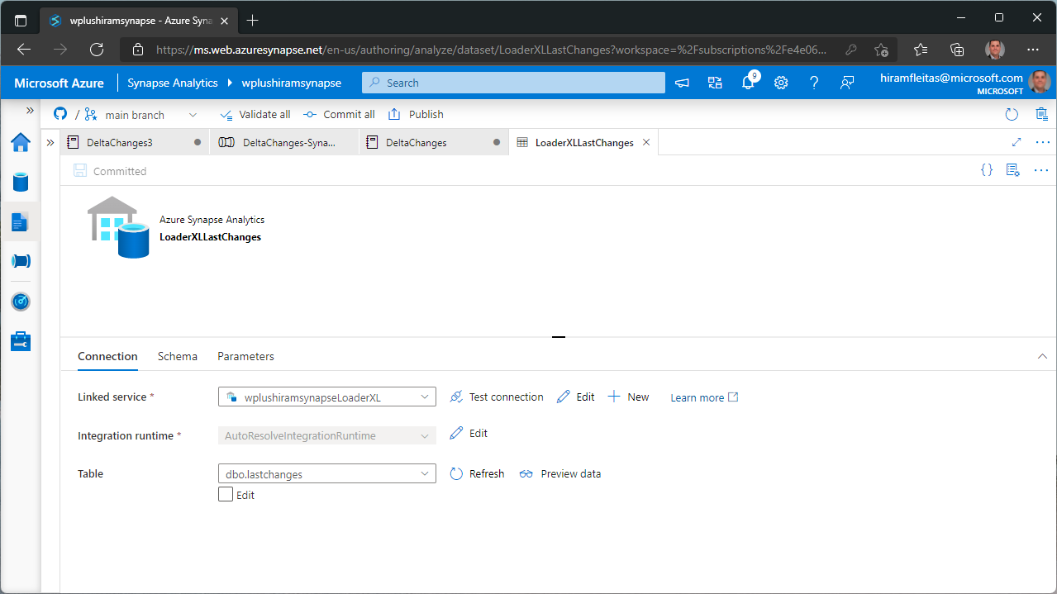

Slide 50
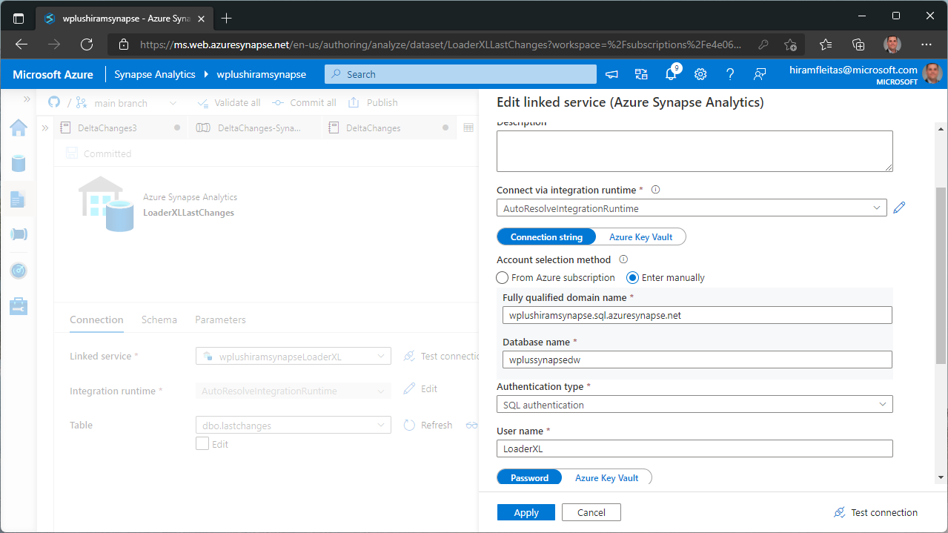

Slide 51
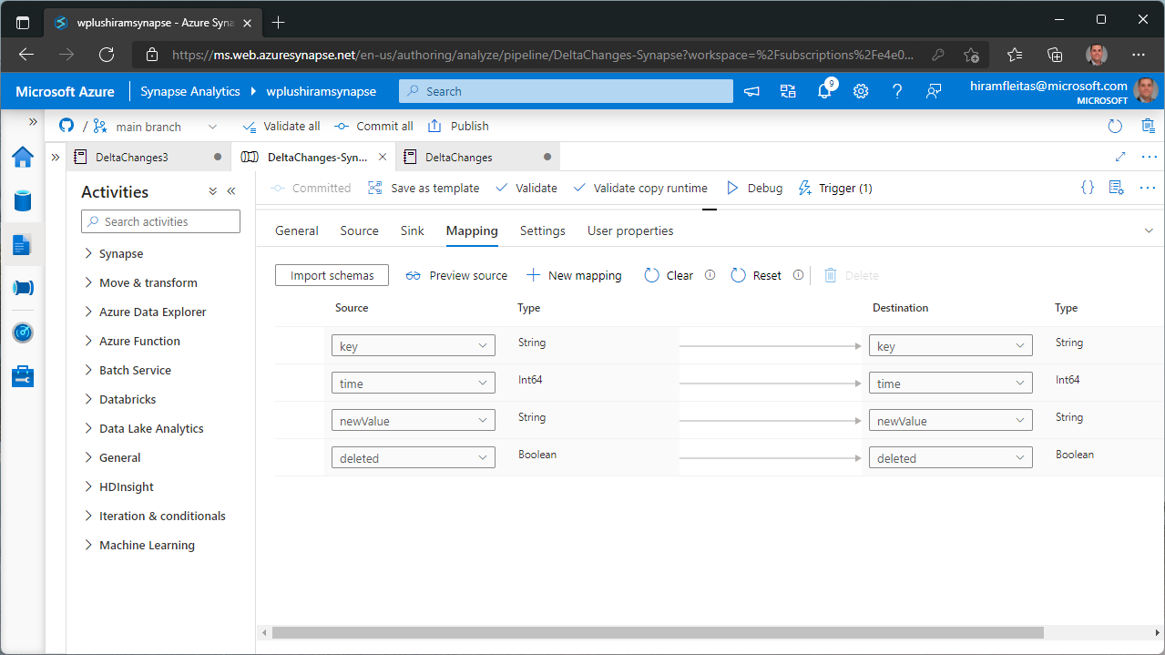

Slide 52
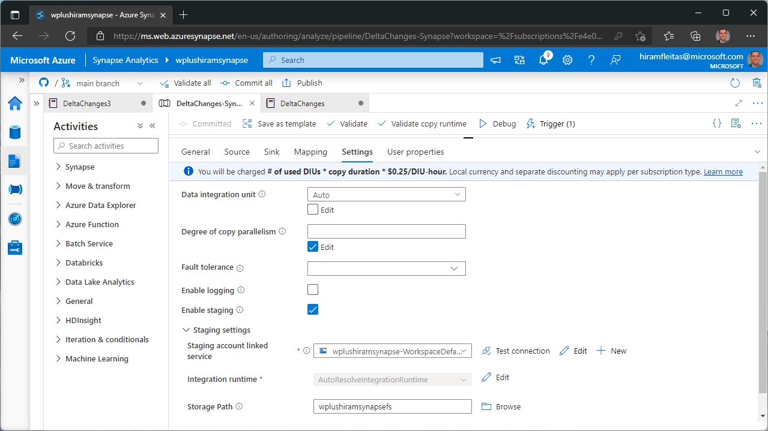

Slide 53
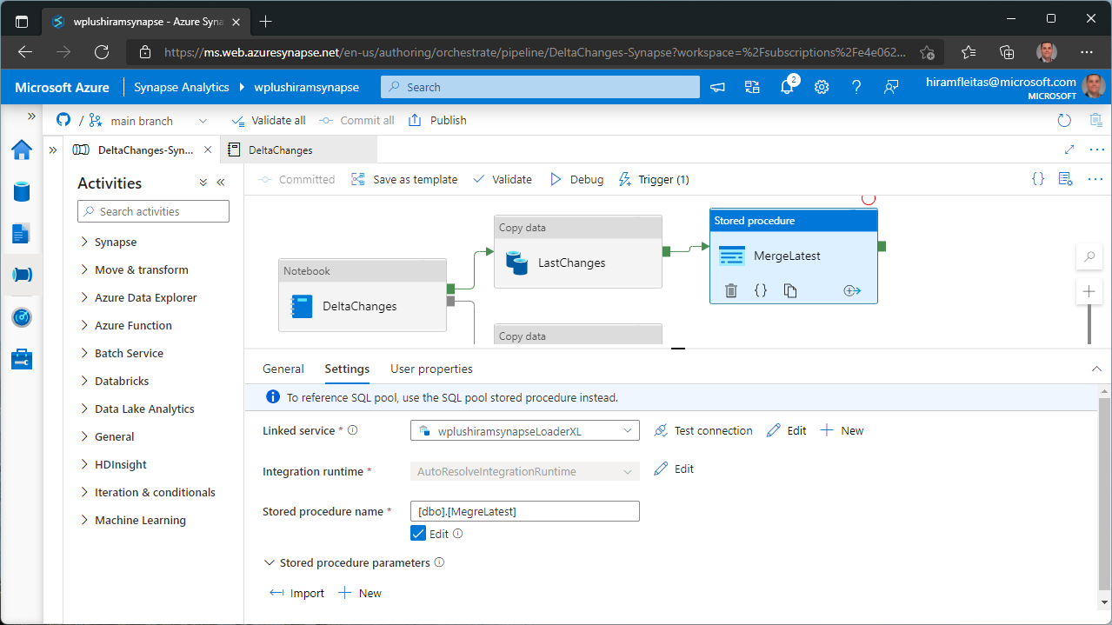

Slide 54
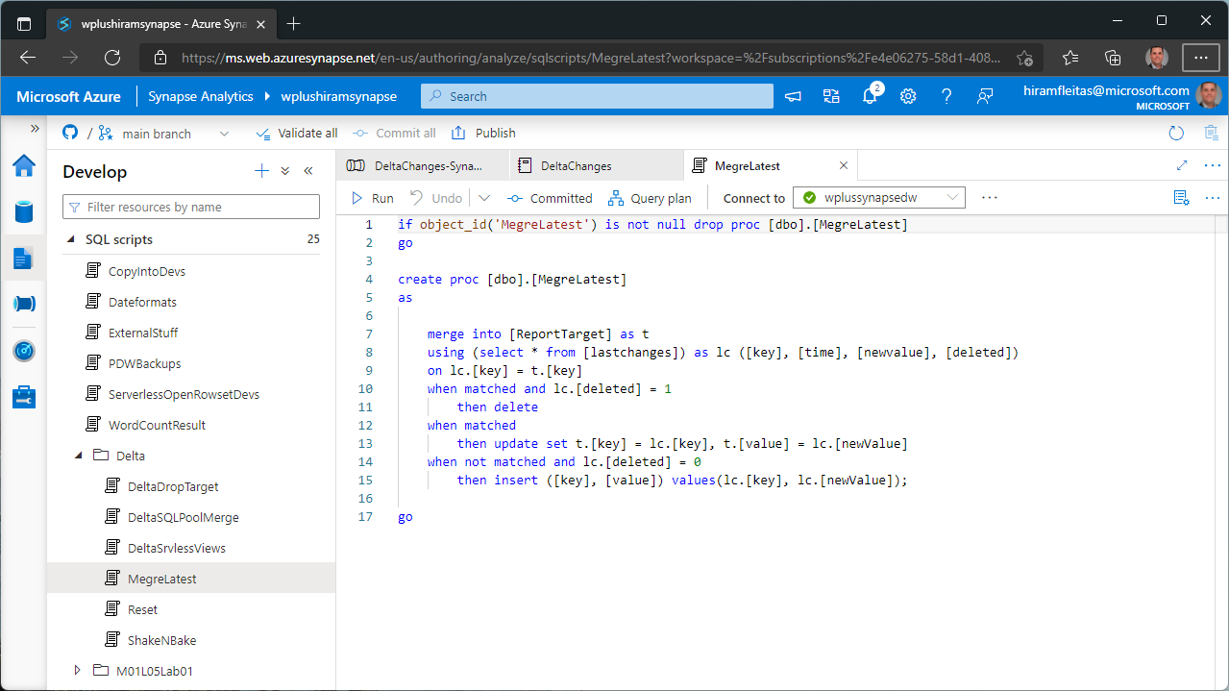

Slide 55
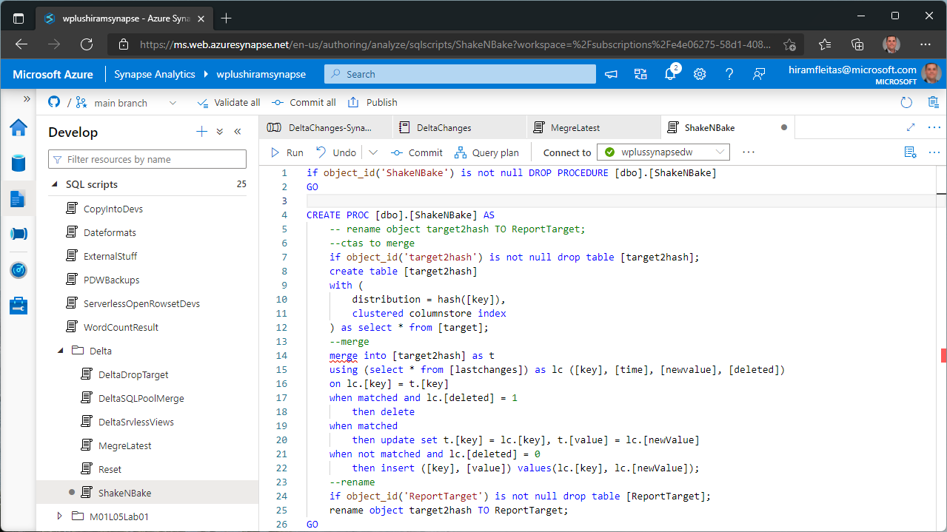
DO NOT USE
Requires reloading target.

Slide 56
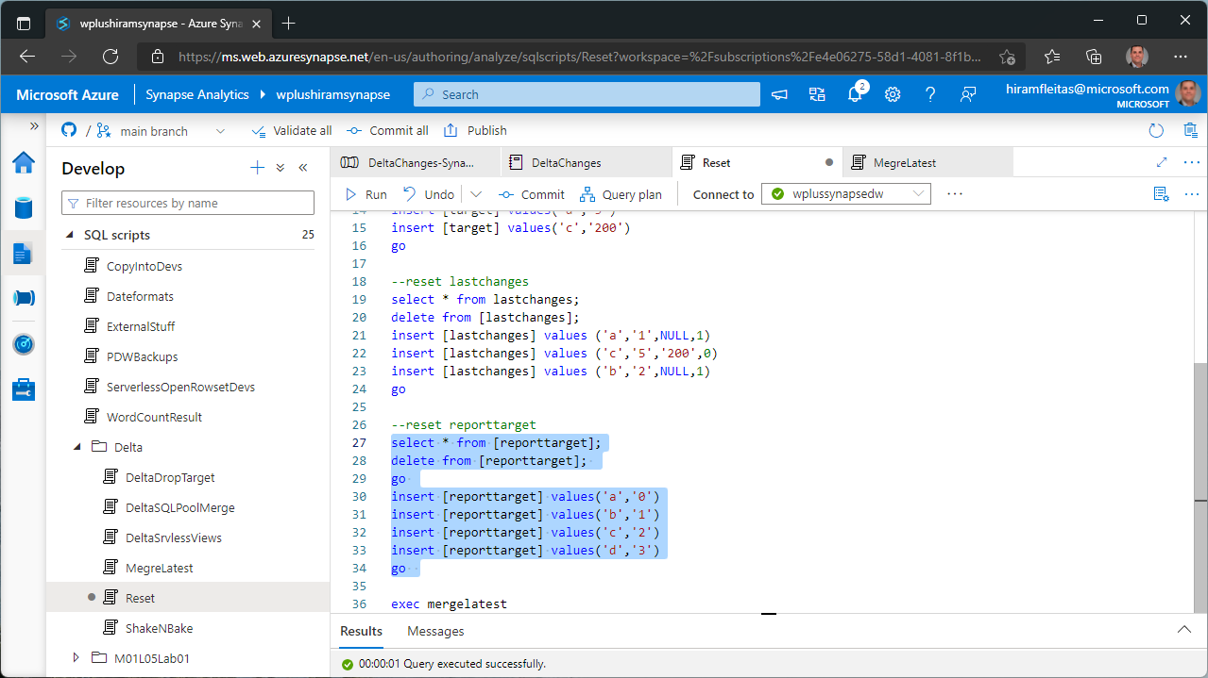

Slide 57
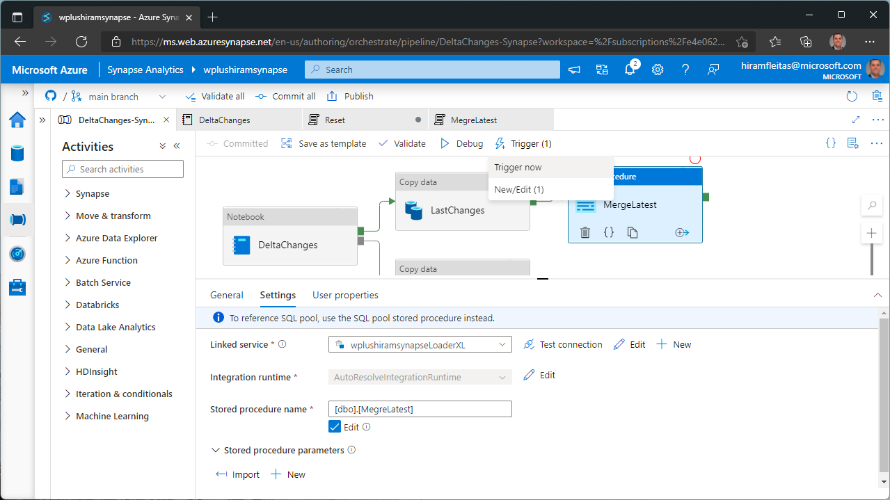

Slide 58
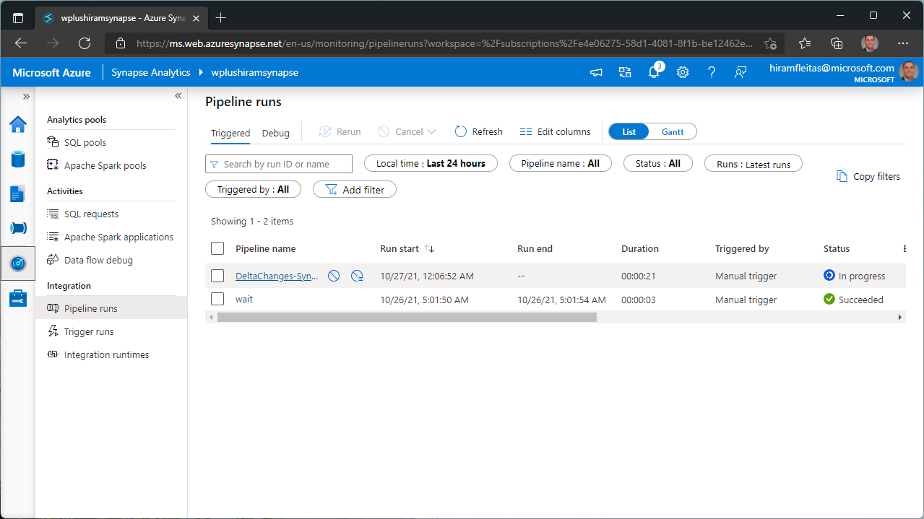

Slide 59
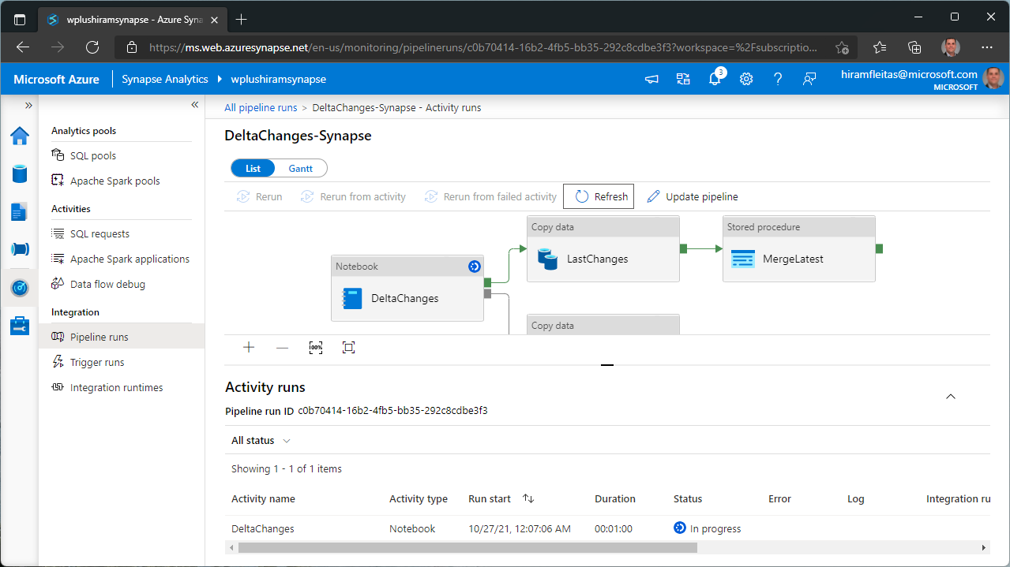

Slide 60


Slide 61


Slide 62


Slide 63


Slide 64


Slide 65


Slide 66


Slide 67
Intro
What is Azure Synapse
What is Synapse Spark
What is Delta format
Spark
Scala delta
APIs
SQL magics & Merge
Serverless
Credential
Openrowset
Pipelines
Activities
Monitoring
Summary

Slide 68
Next Steps
github.com/Azure/Test-Drive-Azure-Synapse-with-a-1-click-POC
Home > Knowledge center > Browse Gallery > Notebooks > Delta
github.com/hfleitas/synapsedelta
dba2o.wordpress.com/2021/10/25/synapse-spark-getting-started
techcommunity.microsoft.com > Blogs > Azure Synapse Analytics
docs.microsoft.com/azure/synapse-analytics/spark/apache-spark-overview
docs.microsoft.com/azure/synapse-analytics/spark/apache-spark-what-is-delta-lake
docs.microsoft.com/azure/synapse-analytics/spark/synapse-spark-sql-pool-import-export

Slide 69
Eval
bit.ly/sql1021
Your feedback is appreciated.

Slide 70
Thank you
Hiram Fleitas
aka.ms/hiram

